Slide 1



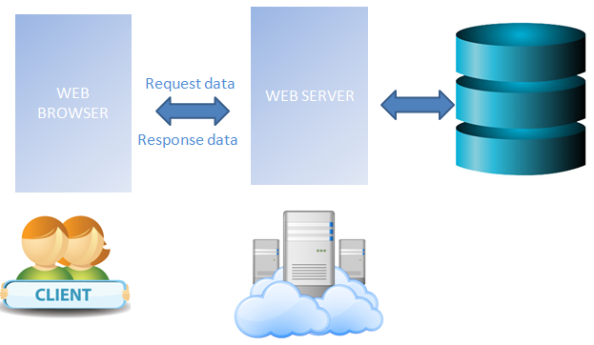
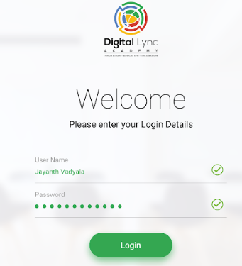
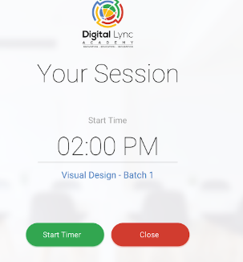

TUTOR E-PAY WAGE MONITORING SYSTEM
A.PRASHANTH KUMAR (15PQ1A0502)
A.SREEJA (15PQ1A0503)
A.RAVINDER REDDY (15PQ1A0501)
Department of Computer Science Engineering
Under the guidance of Mr.B.R.Srinivasa Rao
Tionnt
3
MODULES:
TRAINER
STUDENT
ADMIN
Tionnt
3
ABSTRACT:
ARCHITECTURE:
INTRODUCTION:
Tutor e-pay wage monitoring system is used to get exact wages based on trainer working hours. The purpose of developing this software project is fully automate salary system for an institution or organization. This system is capable of calculating monthly salaries.
Tutor e-pay wage monitoring system is a process which monitors the attendance of a faculty in every class room.
.
FUTURE ENHANCEMENT:
We can give more advance software for wage monitoring system including more facilities.
We will host the platform on line servers to make it accessible worldwide.
More all employee no of days worked, over time, extra money details can be added.
Advantages:
The system is convenient and flexible to be used.
It saves their time, efforts, money and resources.
The enhancements which can be done to increase the applicability and usage of this project.
EXISTING SYSTEM:
SCREEN SHOTS:
In existing system employee or trainer register their attendance manually.
Earlier the system used to pay for the employer based on their attendance , but not on their working hours.
When ever the employer spends the extra time on working they did not get any extra payment.
LIMITATIONS:
Tracking a records is very difficult.
No central database can be created, as information is not available in database.
REFERENCES:
SCOPE OF THE PROJECT:
Some institutions use computerized wage monitoring system so that they work much easier. Their transactions fast in order to avoid waste of time and sake of safety.
PROPOSED SYSTEM:
In this proposed system we will pay the amount to the employers based on the time they will spend in their work.
It provides “Better and Efficient” service to trainers.
Save effort and time
When he press login button the timer starts and when he press logout button the timer stop. If trainer forgot to press logout button, then trainer may not be paid his performance.
REFERENCES:
Head first object oriented analysis and design by Brett D.
Websites:
www.wikipedia.com
www.getbootstrap.com
Notes:
LL

